Slide 1
Building Custom Resource controllers for Kubernetes with Python
PyAmsterdam Meetup

Slide 2
Machine learning lifecycle management

Slide 3
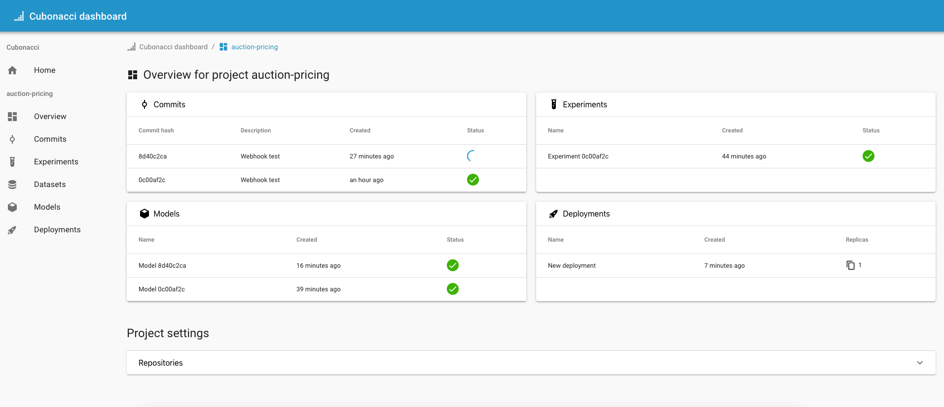

Slide 5
Overview
Kubernetes
Resources
Kubernetes API
Custom resources
Controllers
Metacontroller
Python
Notes:
Kubernetes

Slide 6
Notes:
Production-Grade Container Orchestration
Software engineering layers of abstraction
Abstract away infrastructure
For Cubonacci: Dynamic workloads, run anywhere (with a Kubernetes cluster), scaling

Slide 7
Kubernetes
Node A
Node B
Pod
Metadata
Volumes
Service account
Pod
Pod
Pod
Pod
Container
Image
Environment
Pod
Pod
Container
Image
Environment
Notes:
Nodes
Pods

Slide 8



Kubernetes
Configuration
State
Notes:
Declarative
Reconciliation

Slide 9
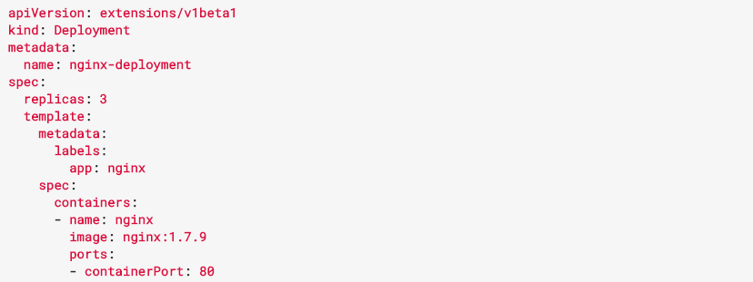
Kubernetes
Notes:
Reconciliation

Slide 10
Resources
Deployment
Volumes
Service account
Pod specification
Update strategy
ReplicaSet
Volumes
Service account
Pod specification
Pod
Pod
Pod
Notes:
Object oriented programming

Slide 11

Kubernetes API
Resources can be watched and manipulated via API
Kubect CLI to API
Accessible via REST
API wrappers in multiple languages

Slide 12

Custom resources
Custom defined resource
Usually based on domain specific logic
Define schema
Abstracts away nitty-gritty implementation

Slide 13
Custom resources
class MyClass: instance = MyClass(A=‘abc’, B=2)
def __init__(A, B):
kind: "CustomResourceDefinition” kind: “ModelAPIDeployment”
spec: spec:
names: configValueA: abc
kind: ”ModelAPIDeployment” configValueB: 2
validation:
configValueA: str
configValueB: int
Notes:
Object oriented programming

Slide 14

Example
Train
Store
Deploy

Slide 15

Controllers
API
Controller
API
watch
apply
Pod
Service
Job

Slide 16
Metacontroller https://metacontroller.app/
Add-on for easier Custom Resource management
Two current features:
CompositeController
DecoratorController
Metacontroller communicates relevant changes via API

Slide 17
Example
ModelAPI
Name
Git repository
Hyperparameters
Endpoint
Number replicas
Deployment
Job
Service
Notes:
Owned by ModelAPI

Slide 18
API
Sync endpoint
(parent, children) -> (status, desired_children)
API implements logic
Return dictionary/map with status and desired state children
Metacontroller keeps track of all changes

Slide 19
Example
ModelAPI
Name
Git repository
Hyperparameters
Endpoint
Number replicas
Deployment
ModelAPI
Name: MNIST
Git repository: …
Hyperparameters: …
Endpoint: …
Number replicas: 2
Job
Service
MNIST
Training
MNIST
Deploying
MNIST
Ready
No children
Job
Job finished
Deployment
Service
Deployment ready
Deployment
Service
Notes:
Owned by ModelAPI

Slide 20
Python
Any API framework can implement this
Flask for small controllers
Django for stateful controllers
Python good choice for Cubonacci

Slide 21
Summary
Custom resources
Controllers
Metacontroller
Python

Slide 22
Thank you for your time

